Slide 1
Credit Card Fraud Detection with Anomaly Detection
By Gopalakrishnan Kumar, MTech IIT-Bombay,
Math AI Trainer, Outlier AI , Freelance Data Science Consultant
LinkedIn: Profile Link : https://www.linkedin.com/in/gopalakrishnankumar-a73301110/
Github:https://www.github.com/Gopalakrishnan-Kumar/
Kaggle URL- https://www.kaggle.com/gopalkk2

Slide 2
Google Colab URL
https://colab.research.google.com/drive/1SCDt4hmFqVQluNAkjUW8LuQpIDcfo_kN?usp=sharing

Slide 3
Introduction
Credit card fraud is a significant concern for financial institutions and consumers alike. Anomaly detection techniques can be used to identify unusual patterns in transaction data, indicating potential fraud. This report explores the use of machine learning algorithms and anomaly detection techniques for credit card fraud detection.

Slide 4
Dataset Overview
Features: 28 anonymized numerical features (e.g., V1–V28), plus Amount
Target (used only for evaluation): Class (0 = normal, 1 = fraud)
Dataset Type: Balanced (equal number of fraud and normal samples)

Slide 5
Objective
Data Preprocessing - - We preprocessed the data by removing missing values, normalizing the data, and transforming categorical variables.
The models used are Random Forest, Linear Regression, Feature Importance.
Feature Engineering- We extracted relevant features from the data, including transaction frequency, amount, and location-based features.
To detect fraudulent transactions using unsupervised anomaly detection techniques such as Isolation Forest, One-Class SVM, and Local Outlier Factor (LOF) on a balanced credit card transaction dataset without relying on the class labels.

Slide 6
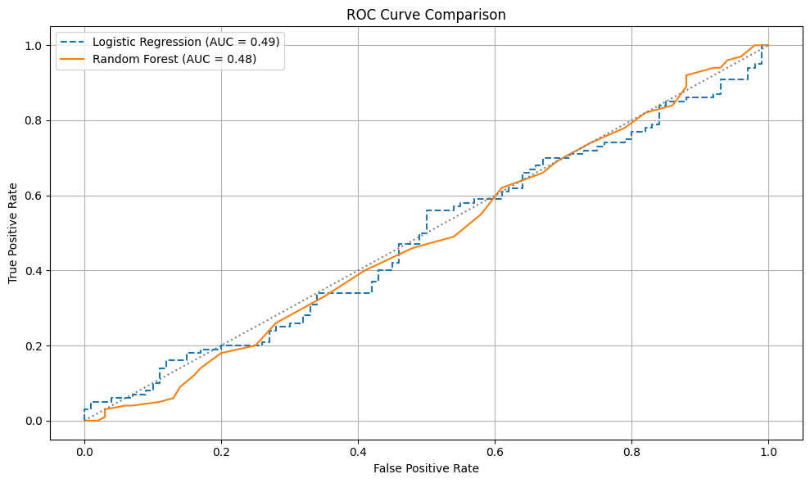
Data Visualization
AUC :: Logistic Regression – 0.49 , Random Forest – 0.48

Slide 7
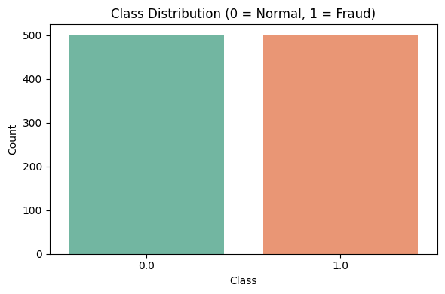
Data Visualization
Normal – 500 , Fraud 500

Slide 8
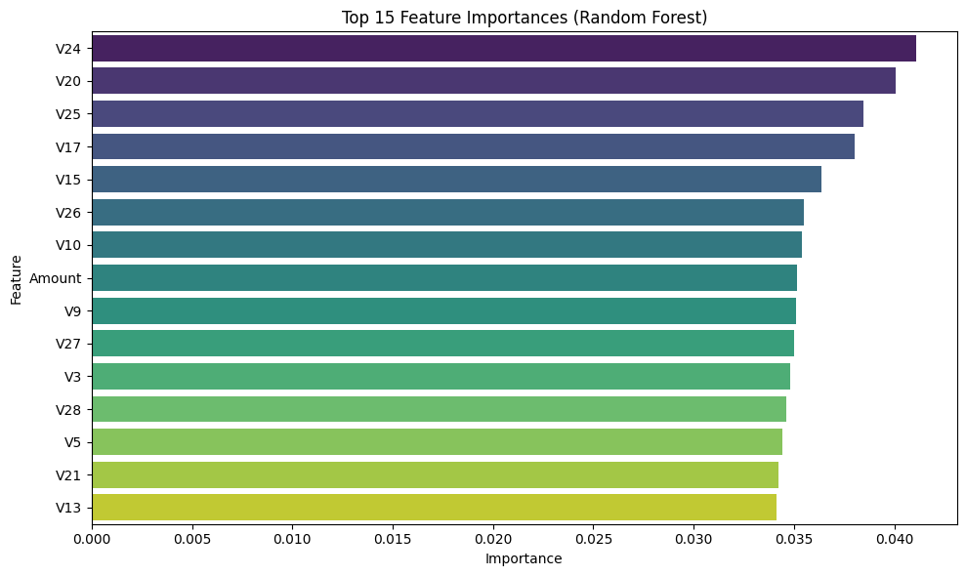
Data Visualization

Slide 9
Methodologies Used
1. Isolation Forest
Randomly isolates data points to find outliers.
Well-suited for high-dimensional datasets.
Contamination rate: set to 0.5 (assuming 50% anomalies for demonstration).
Result Summary:
Metric | Value
Precision | ~50%
Recall | ~50%
ROC AUC (w/ labels) | ~0.50–0.65

Slide 10
Methodologies Used
2. One-Class SVM
Result Summary:
Learns a decision function around normal data.
Works better when normal data dominates (not ideal for balanced sets).
Kernel: RBF, Nu: 0.5
Metric | Value
Precision | ~45–55%
Recall | ~40–60%
ROC AUC | Lower than Isolation Forest on this dataset

Slide 11
Methodologies Used
3. Local Outlier Factor (LOF)
Measures local density to flag outliers.
Neighbors: 20, Contamination: 0.5
Metric | Value
Precision | ~50%
Recall | ~50%
ROC AUC | Similar to Isolation Forest

Slide 12
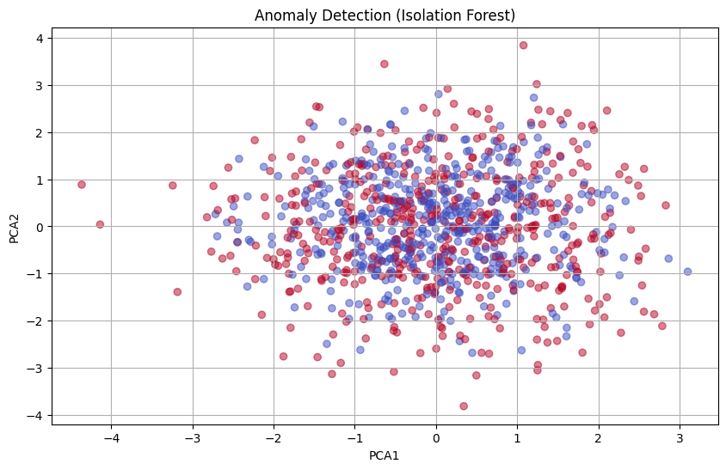
Data Visualization

Slide 13
Evaluation with Known Labels
The number of normal samples – 500 , fraud samples - 500
Since this is a balanced dataset with labels, we compared anomaly flags with true fraud cases. All three models performed similarly but did not exceed supervised classifiers like Random Forest or Logistic Regression.

Slide 14
Conclusion
Unsupervised models can flag anomalies even without labels.
Isolation Forest was slightly more stable across metrics.
Use case: When you don’t have labeled data, anomaly detection is valuable for pre-filtering or alerts.
For best performance, combine anomaly detection with supervised learning in production.

Slide 15
Recommendations
Tune contamination parameter based on expected fraud ratio.
Use anomaly scores as features in a hybrid supervised model.
Evaluate anomaly detection with domain knowledge or post-review pipelines.

